Slide 1


Slide 2



Safety Spotlight
Act Your Age
Notes:
Today’s Safety Spotlight is called Act Your Age and is focused on a sometimes-overlooked cause of accidents at work: Horseplay.

Slide 3
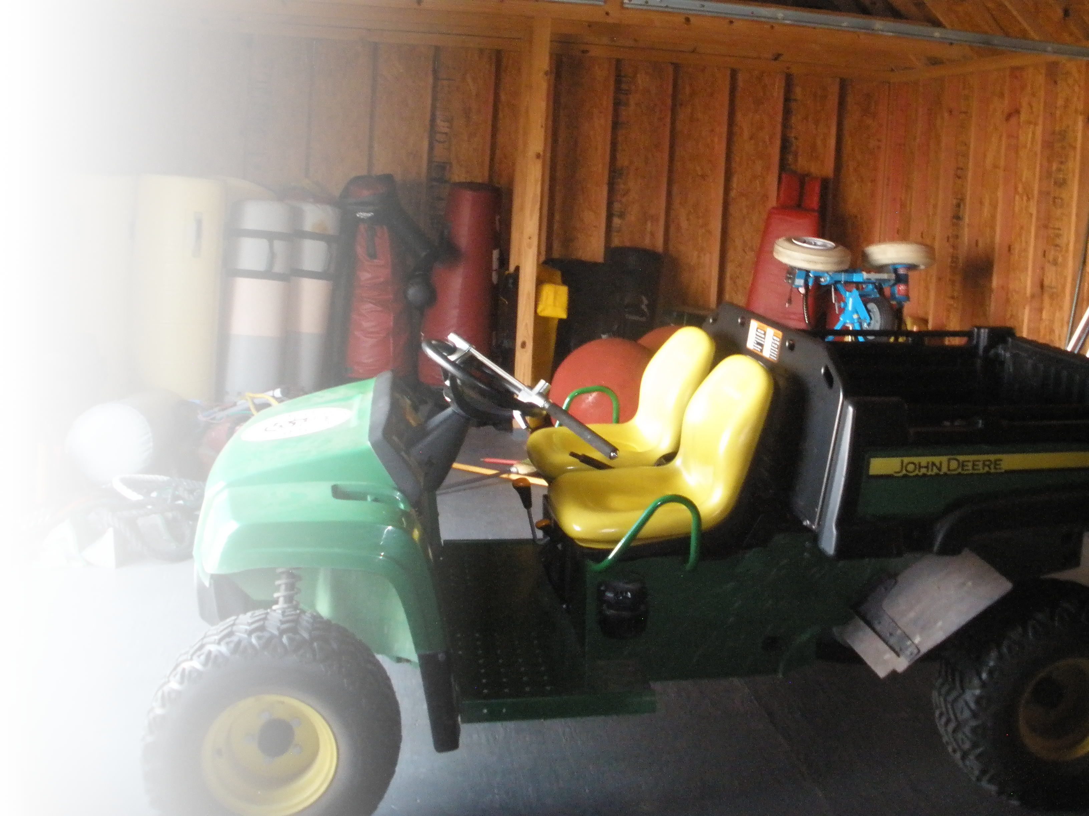
Employee fractures lower leg and ankle after
A university employee driving a John Deere Gator UTV flipped the vehicle on a paved road, pinning his left leg. While the employee claimed he was driving to the restroom, responding coworkers discovered circular scorch marks on the asphalt indicating he had been doing "donuts."
The employee freed himself to call for help and was hospitalized for surgery to treat a compound fracture in his lower leg and ankle
Notes:
A quick search of OSHA accident reports reveals several recent serious injuries and even fatalities related to horsing around. Here’s an example involving a “Gator” UTV, similar to those that are used by many school (county) maintenance departments.
[click for text and read the displayed description]

Slide 4

Employee fractures leg during horseplay with other worker
A garage employee was running away from another employee during horseplay. The employee ran into an area where a different worker was breaking apart a bale of cardboard. The running employee slipped, causing the cardboard contents to fall onto his leg, which was fractured.
Notes:
And here’s one that happened in a service garage:
[click and read the displayed accident description]
I’m sure you all get the point that horseplay on the job can turn out very badly.

Slide 5
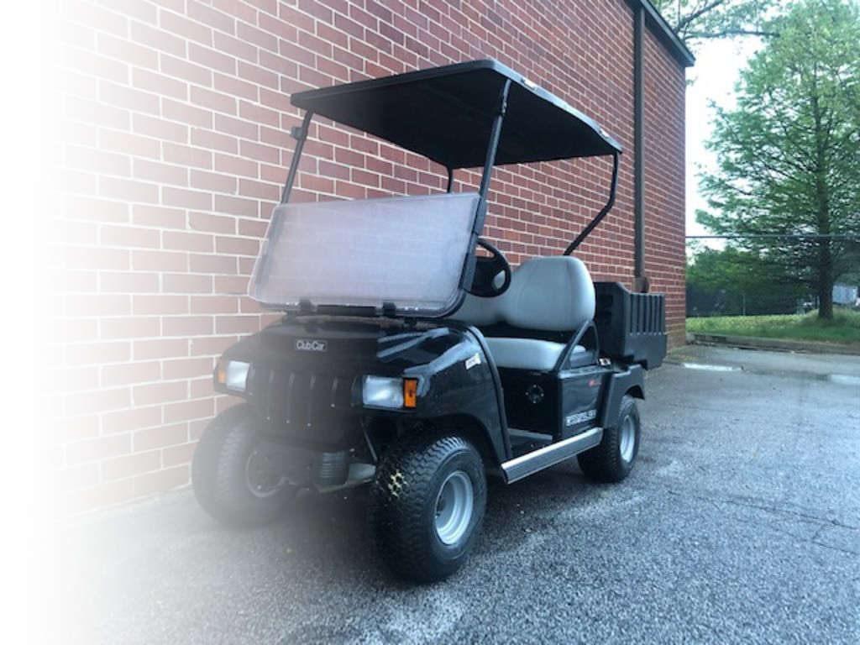
Horseplay with utility vehicles in out Workers’ Comp Programs
Overturned golf cart with multiple passengers thrown off.
Overturned utility cart – crushed hand
Overturned utility cart – multiple fractures
Notes:
[click for individual bullet points]
Fortunately, we haven’t had a large number of horseplay related accidents in our programs over the years, but we have had some serious occurrences involving golf carts & utility carts.
If you drive a utility vehicle at work, make sure you take its safe operation as seriously as if you were driving a full-size vehicle. This requires overcoming distractions, frequently scanning ahead, left and right and driving at a safe speed. And never using the vehicle as a toy.

Slide 6
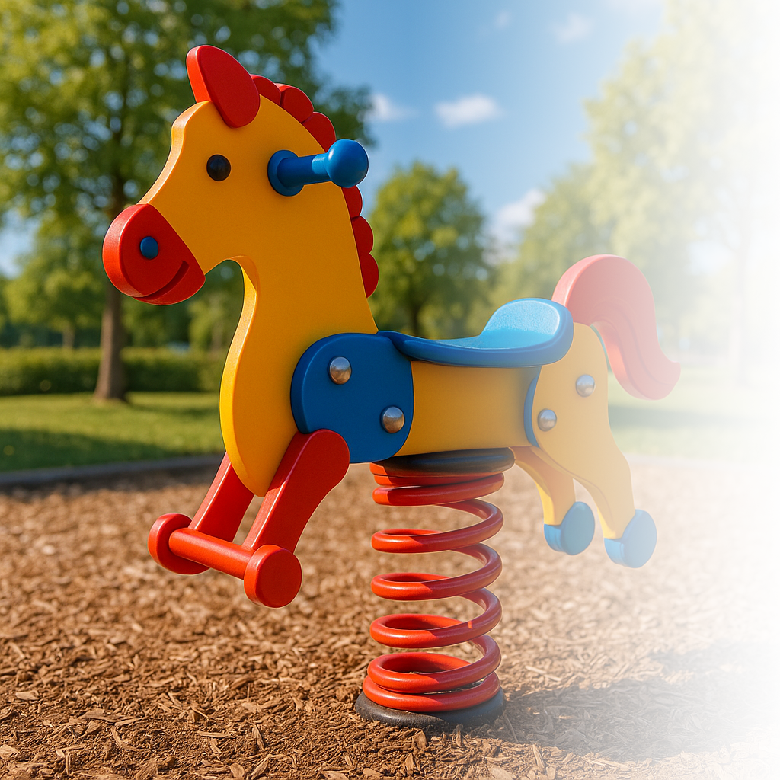
Fun and games more – WC Claims
Playing game with student – fell and struck face concussion.
Running down hallway – slipped and fell contusion.
Playing hopscotch with coworkers - fell awkwardly - inflammation
Notes:
As you can see, we’ve also had auxiliary workers injured while playing games with students and coworkers. I can assure you that these accidents are very common among teachers and coaches.
It’s important for us to recognize our physical limitations when deciding whether to run, jump or play, even when trying to interact positively with students. The older we get, the less we can count on stamina, balance and flexibility. In these situations, it is very important to Act Your Age.

Slide 7

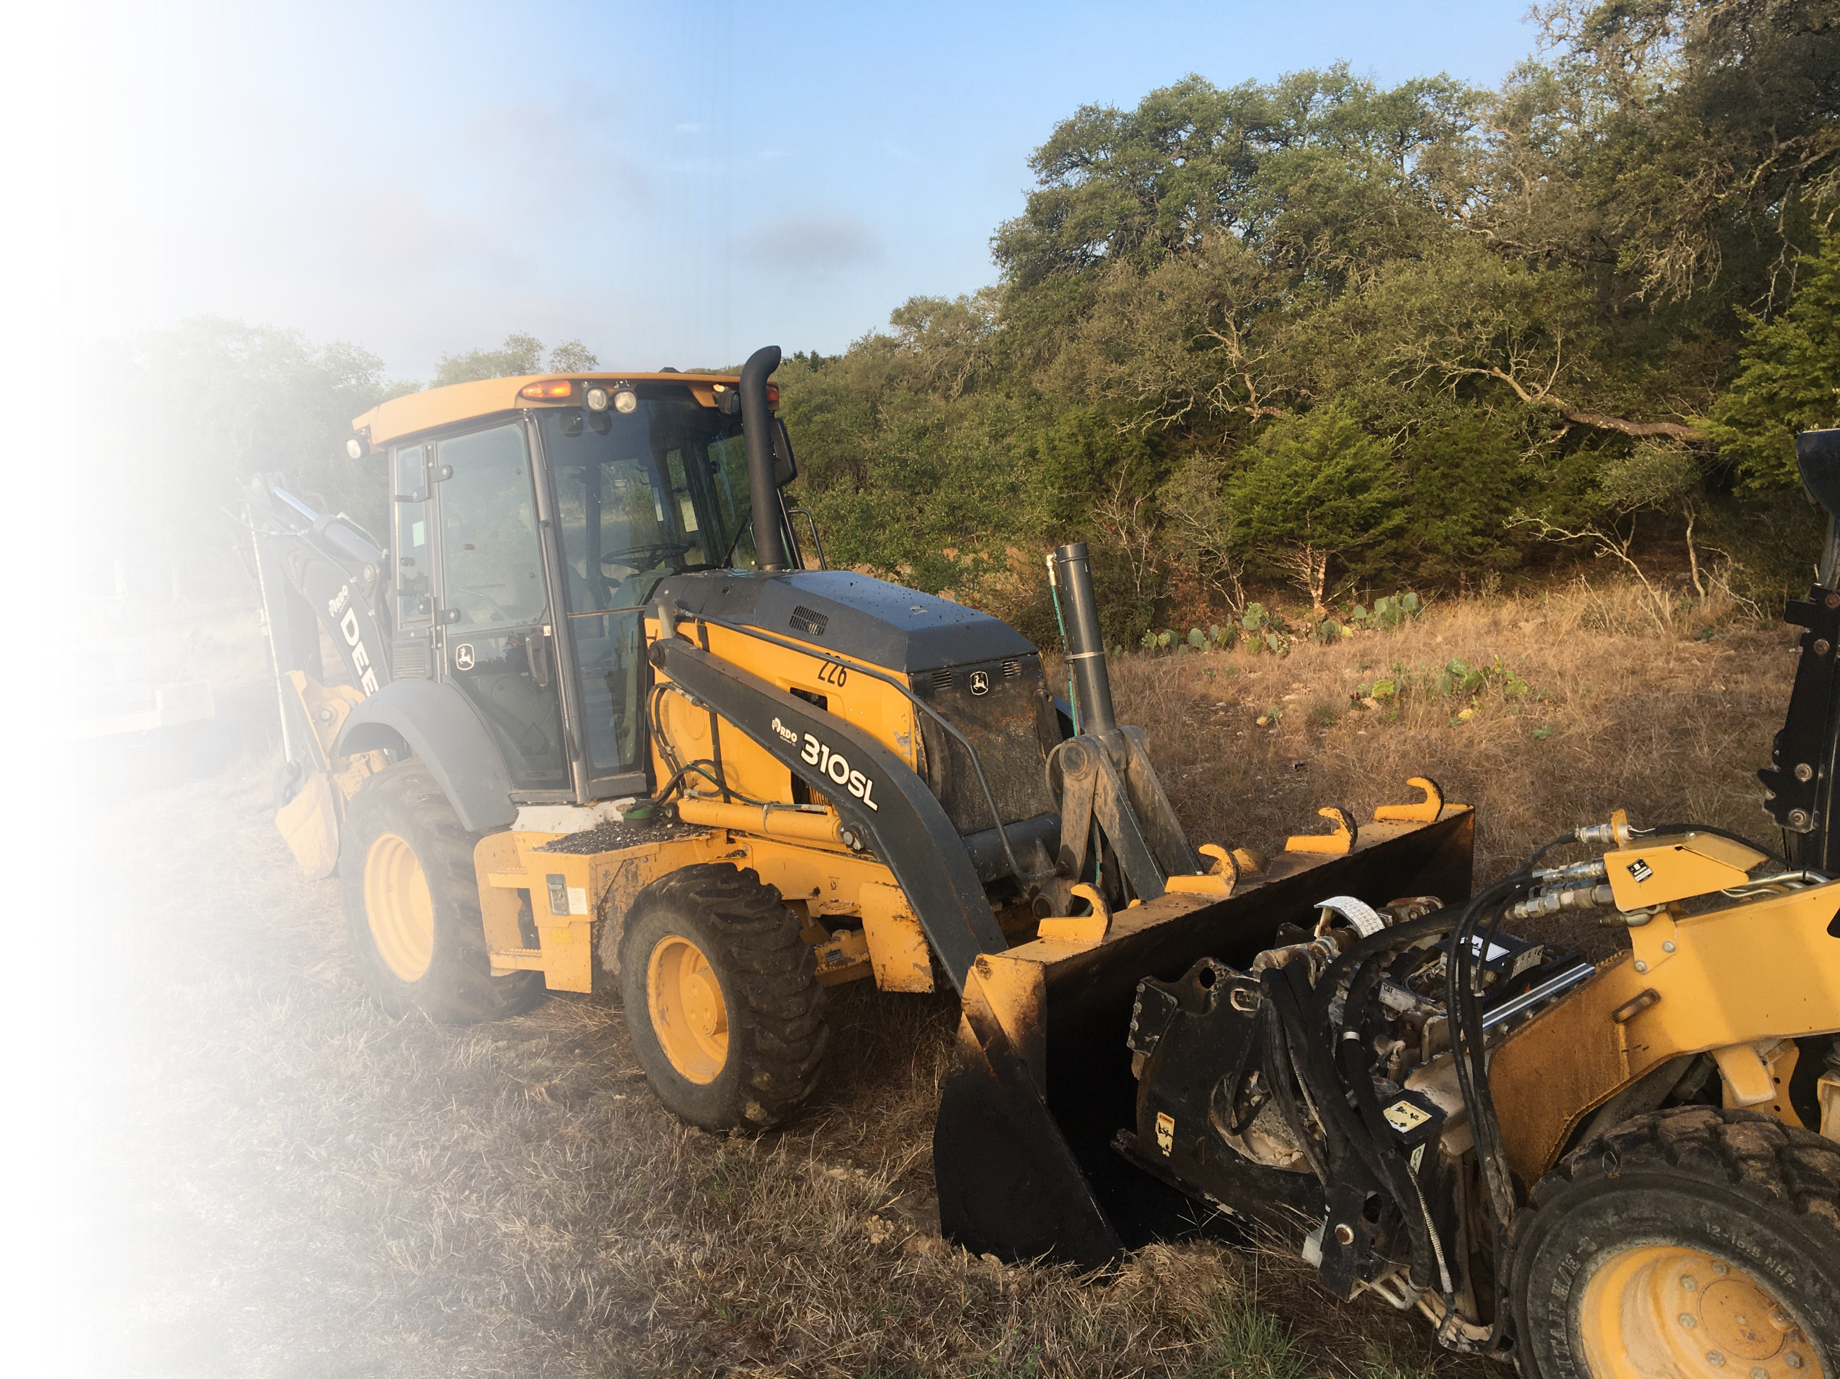
Running or rushing to help
Food service worker running to check on coworker after a cooler fell – tripped and struck arm & leg on cart
Bus driver rushing to chase after student who ran off the bus – fell on wrist and knee
Bus driver jumping from emergency exit during evacuation training
Notes:
[display each bullet individually, one after the other, shortly after the slide is called up]
Among auxiliary workers, we have had some non-horseplay running & jumping injuries recently. As you can see, the top two were related to situations that might have seemed urgent to the injured worker. We’ve had many such accidents with teachers, administrators and paraprofessionals who have run after a student or toward the scene of an altercation.
The third example happened as the driver was conducting bus evacuation training, so it was presumably more of a conscious choice. In the past, we have received leg and back injury claims resulting from the decision to jump from trailers, tailgates, platforms, ladders and heavy equipment cabs. If you have a choice whether to step down or jump down, we recommend stepping.

Slide 8

Respond calmly and under control
Reduce the risk of falling
Maintain your ability to assess the situation / environment
Think clearly and calmly
Notes:
We recommend reacting to urgent situations the same way EMS responds to an emergency: calmly and under control. EMS workers are trained not to run or rush to an emergency scene for a variety of reasons.
[click]
Most importantly, there is a risk of falling. An EMS worker with a broken leg won’t be of much help during a medical emergency, will he?
[click]
Secondly, rushing hinders the responder’s ability to assess the situation and the environment.
[click]+
And 3rd, rushing affects the responder’s ability to think clearly and calmly.

Slide 9
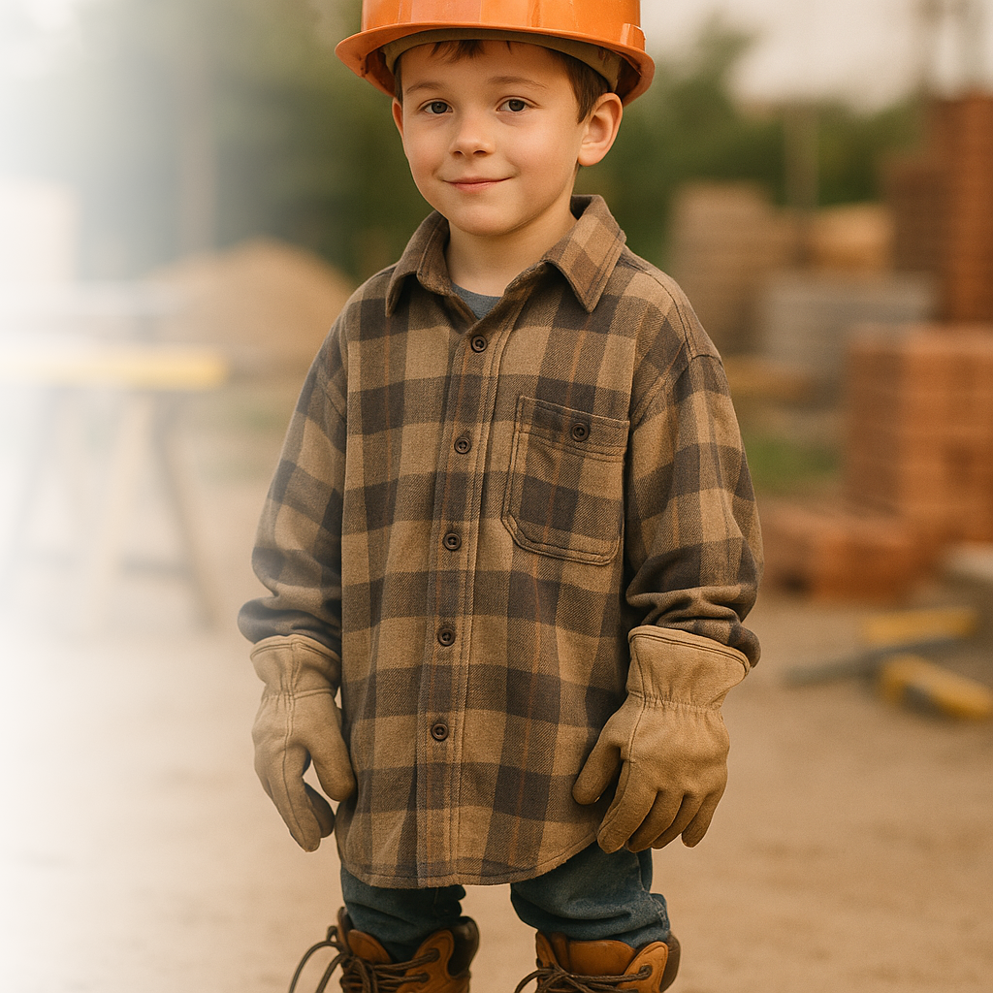
Act your age
Stay calm when responding
Notes:
In closing, let’s all remember to Act Our Age, knowing that horseplay can result in serious or even fatal injuries at work. Sure, it can be fun, but there are other, safer ways to bond with coworkers and make the workday more enjoyable and interesting. There are plenty of other hazards at work that deserve your attention.
If responding to an emergency, remember to stay calm and avoid running or rushing. Your response will be more effective if you provide help promptly, but under control.
That’s it for our Safety Spotlight. Now let’s go to the main program.

