Slide 1
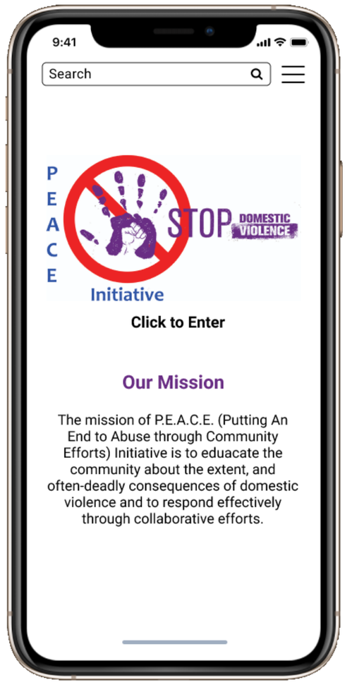
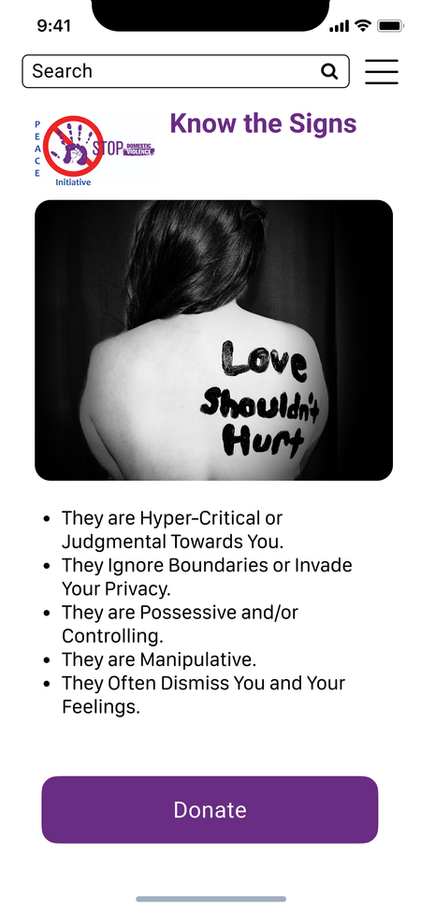
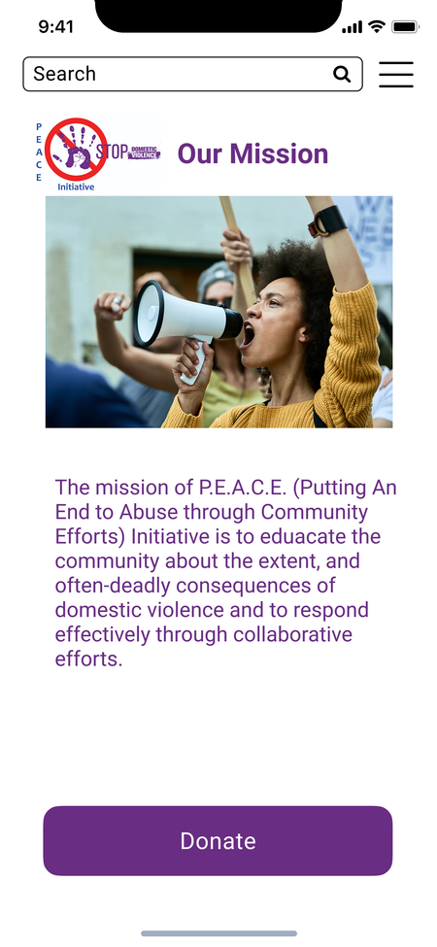
P.E.A.C.E.
Mobile
App
Year: 2021
Duration: 2 months
Native Mobile App
Tools Used: Figma, Miro, Visual Studio Code, Photoshop, Github,
My Role: UI Design, User A/B Testing, User Research, Logo Creation.

Slide 2

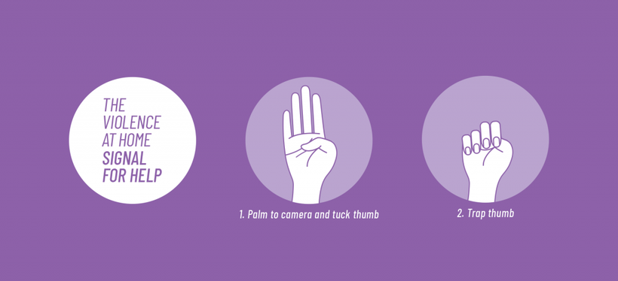
Bexar County
remains one of the most dangerous areas for domestic violence victims. We are changing that narrative through community-wide education and direct support for survivors of all ages—from children to seniors.
To bridge the gap between information and immediate.

Slide 3
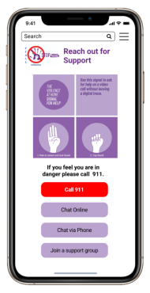
Challenge
Build an essential digital toolkit for emotional emergencies. By combining a minimalist design with evidence-based crisis resources, our app ensures that help isn't just available—it’s accessible in seconds. No hurdles, no complexity; just the support you need, exactly when you need it.

Slide 4
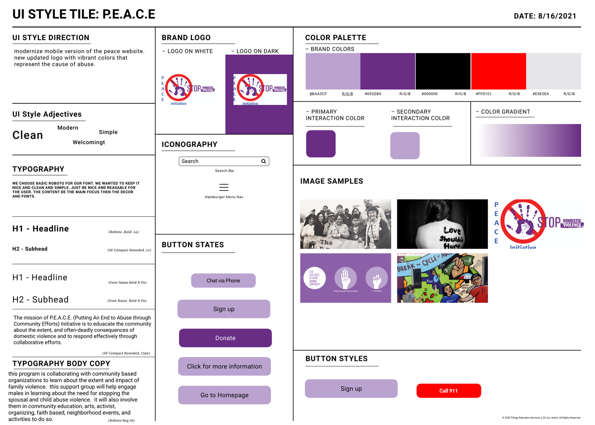
Style Guide

Slide 5
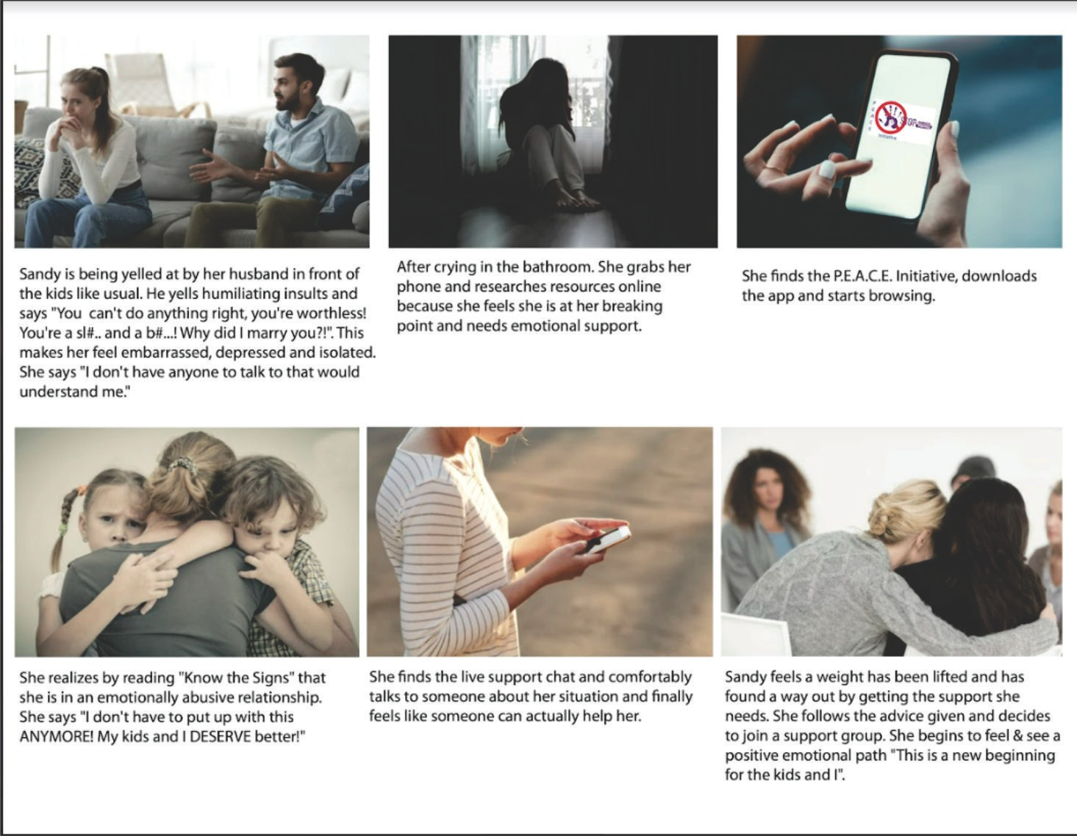
Storyboard
  Provided the framework to translate our research into realistic domestic personas and scenarios.
  Strengthened our narrative regarding user-defined domestic dynamics discovered during our research.

Slide 6
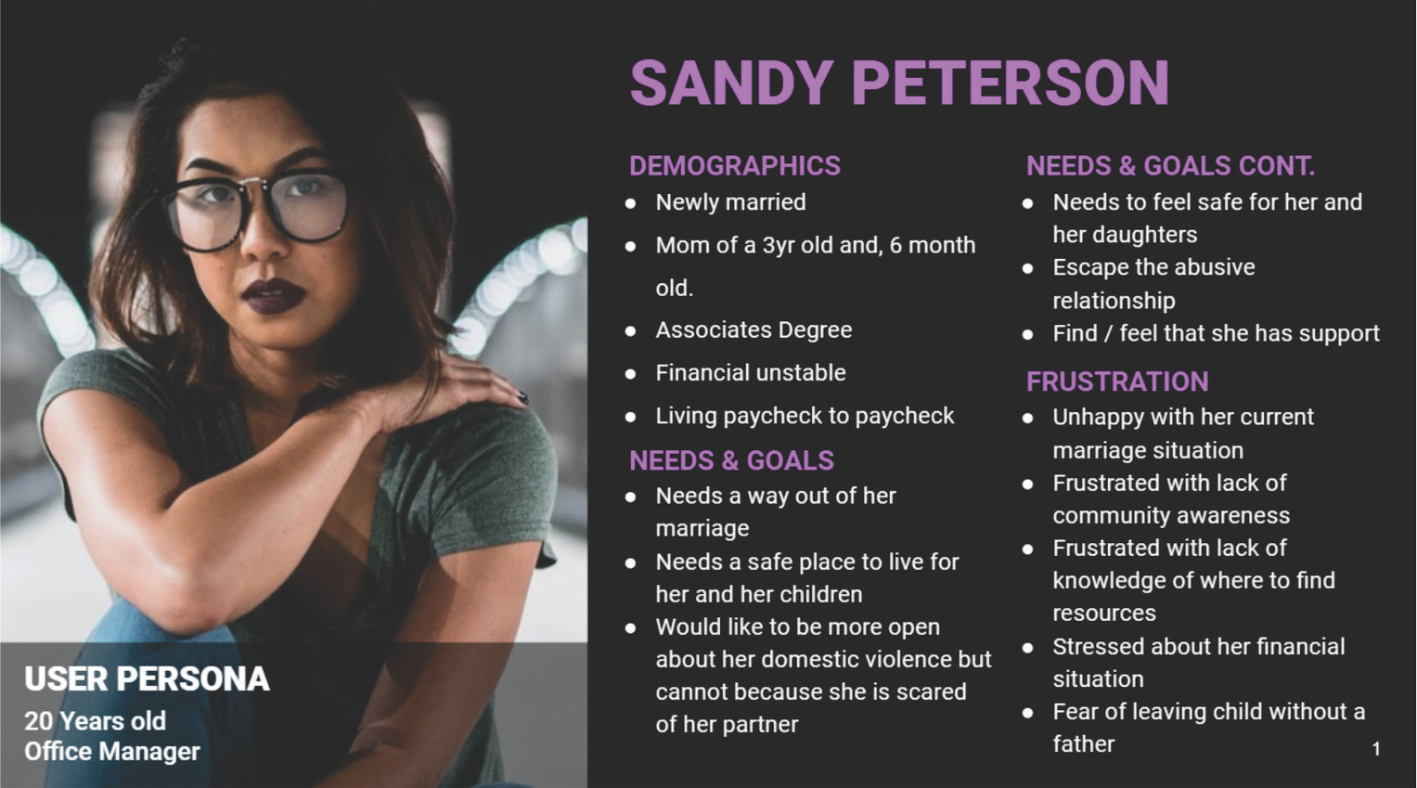
With research we developed a
User Persona
to ground the app’s development to understand the reality of a survivor’s daily life, ensuring that every feature accounts for the unique constraints of living under surveillance.

Slide 7

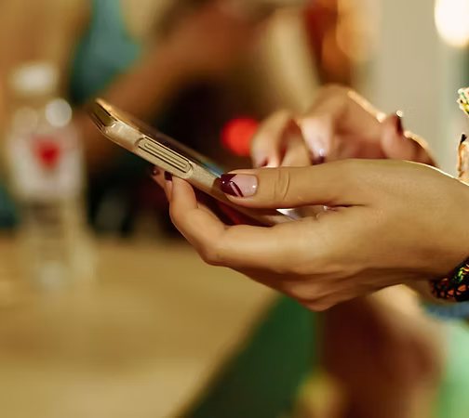
Patricia S. Castillo
Executive Director
User Research
Problem Identification Our research, supported by an interview with the Director of the P.E.A.C.E. Initiative, highlights a critical crisis: Bexar County remains one of the most dangerous regions for women and children regarding domestic violence. While the organization’s current digital presence aims to serve a broad demographic—spanning all ages and genders—there is a vital need to more effectively educate the community. The challenge lies in creating a platform that addresses the universal nature of domestic violence while providing tailored, life-saving resources for diverse groups.

Slide 8

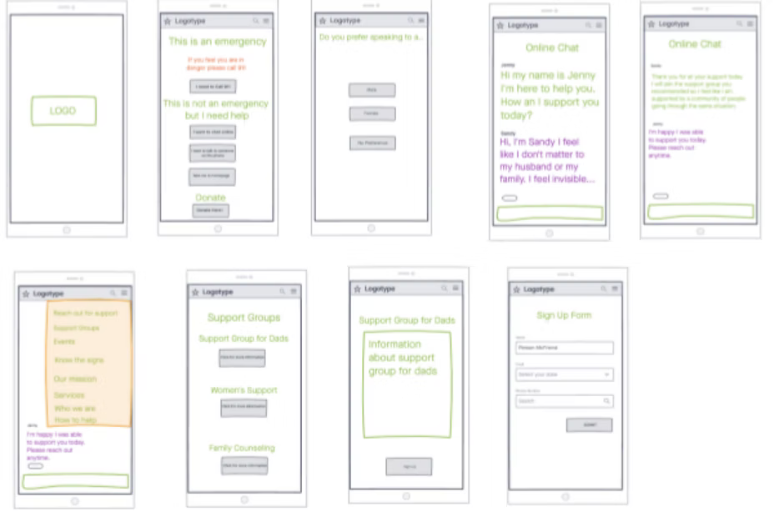
Wireframe
Wireframe and Prototype
Utilizing Figma, we engineered high-fidelity wireframes that integrate interactive learning modules and visual storytelling to guide users through key product features.

Slide 9
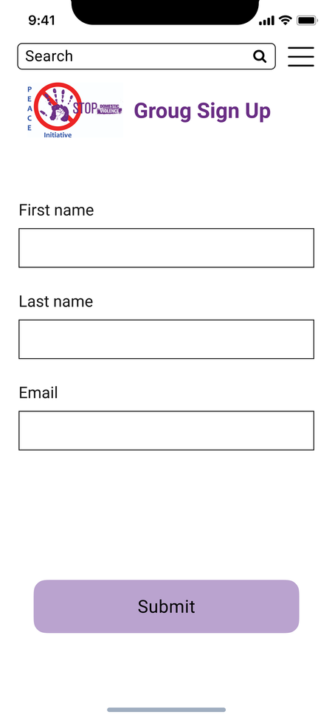
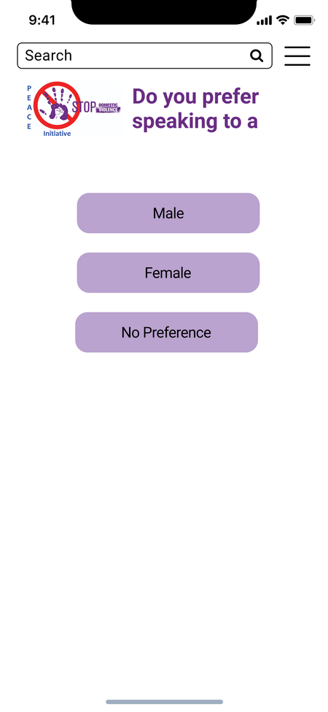
Prototype

Slide 10
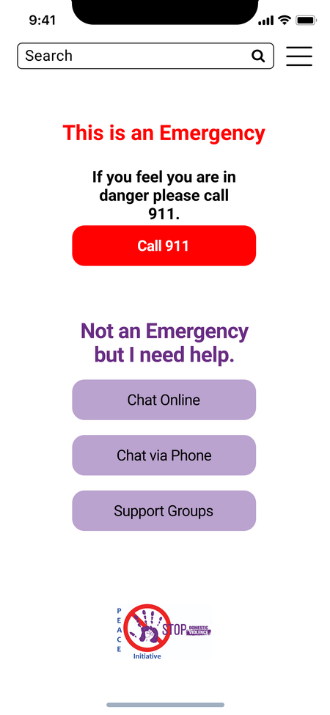
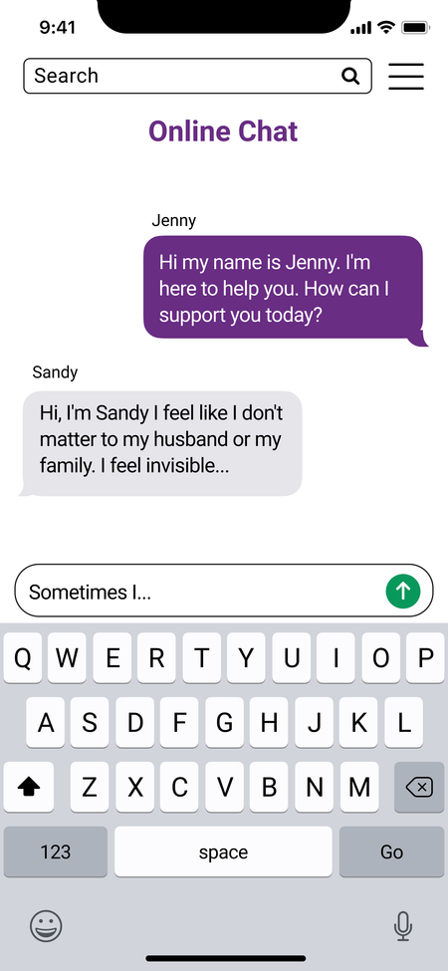
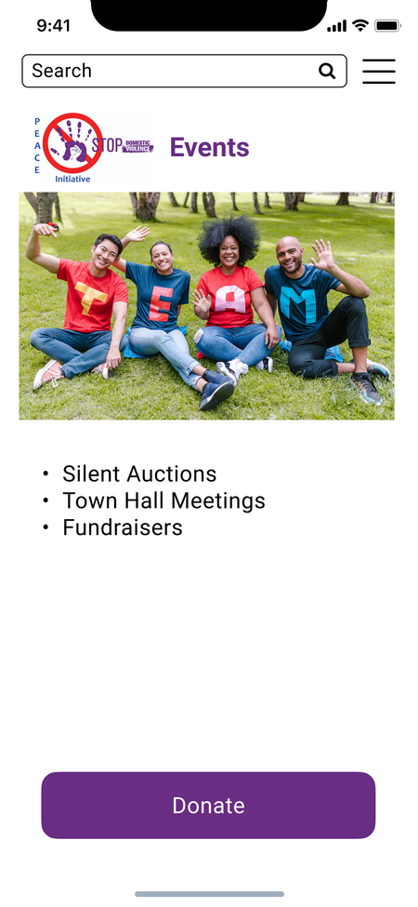
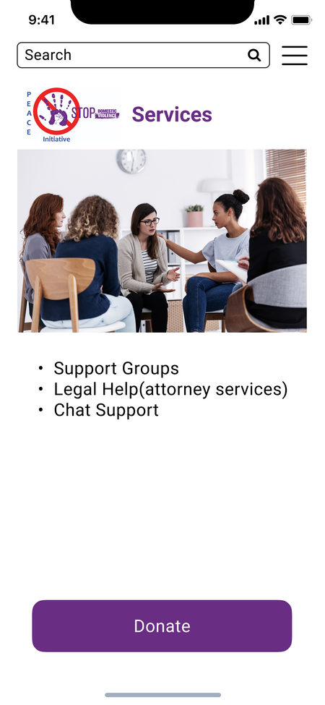

Slide 11
Proposed Solution: P.E.A.C.E. Initiative Mobile App
Our solution is a dual-purpose mobile application that provides:
  Crisis Intervention: Immediate, discreet tools for users navigating high-stress domestic situations.
  Educational Modules: Comprehensive resources to raise awareness and improve how the Bexar County community identifies and responds to domestic violence.
  Advocacy Integration: Centralized access to local support networks and systemic advocacy efforts.

