Slide 1
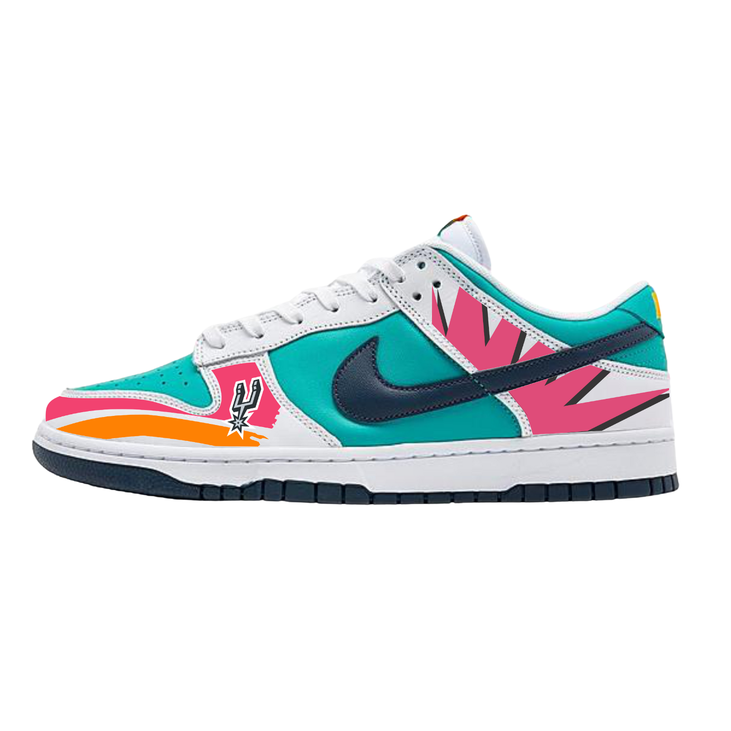

SAN ANTONIO
SPURS
CUSTOM SHOES FIESTA EDITION

Slide 2
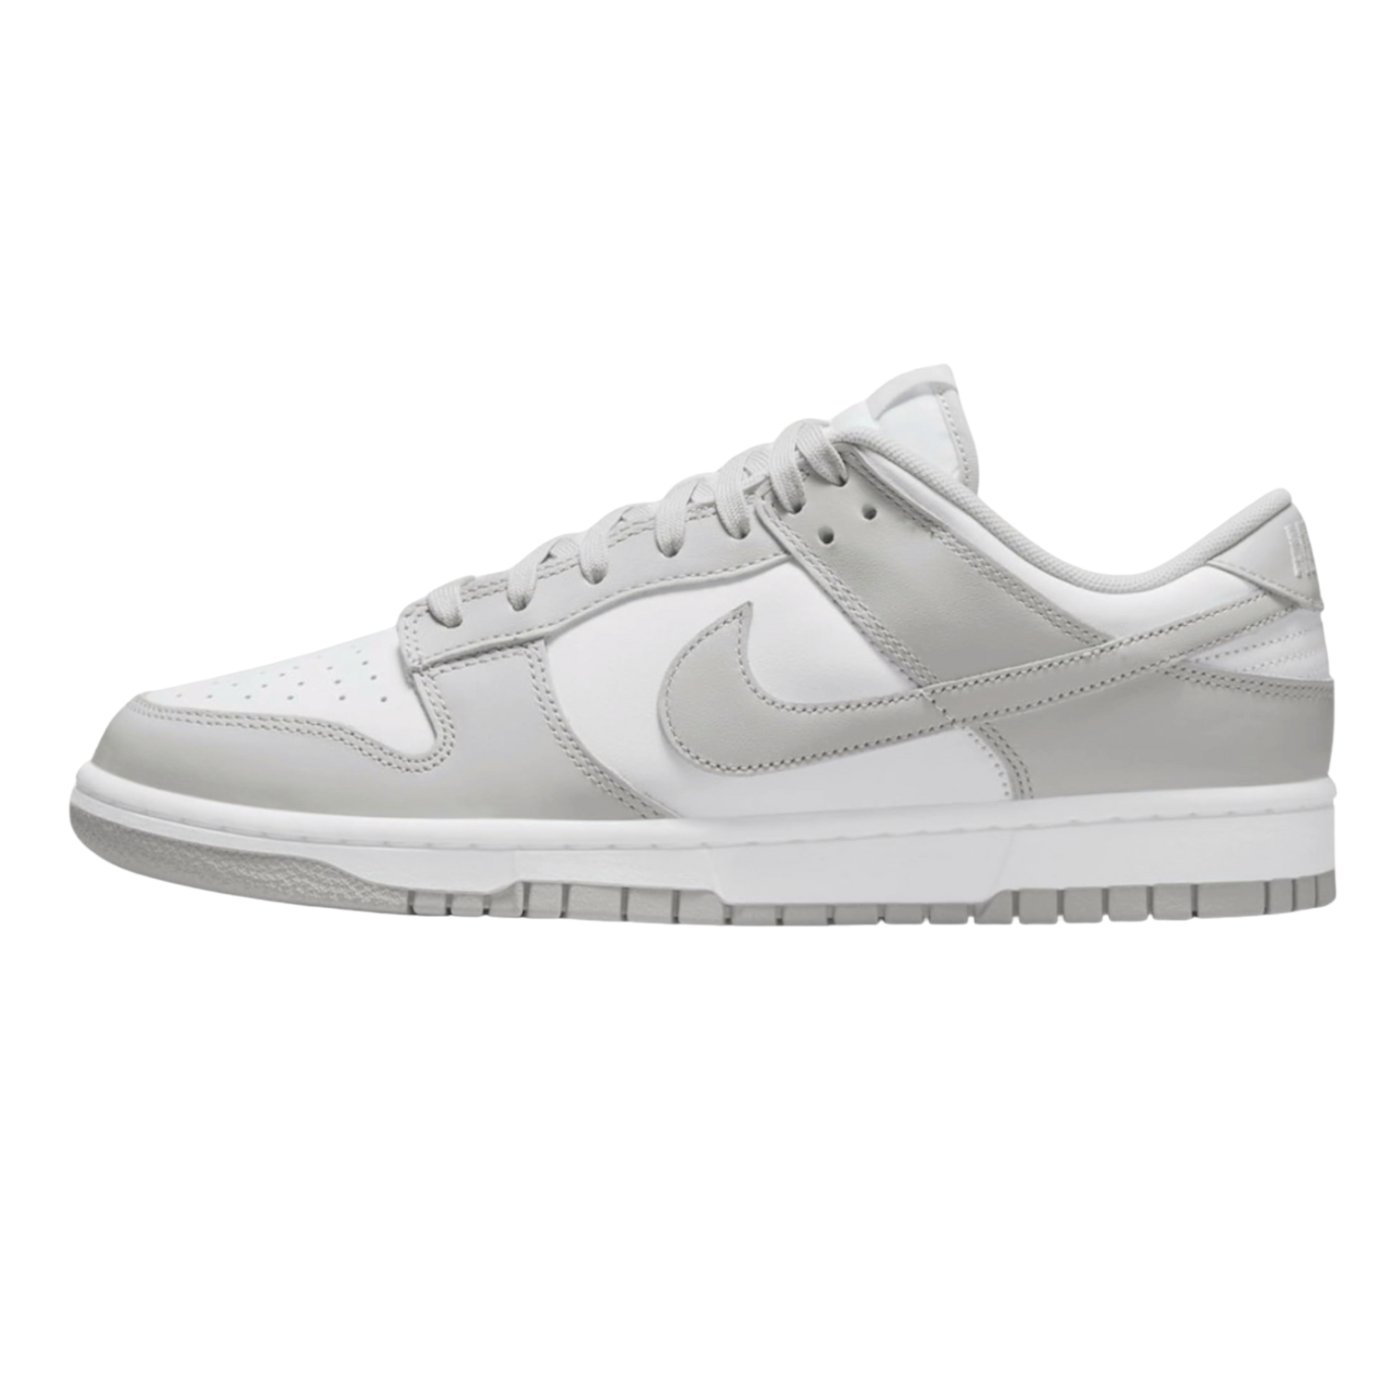
INTRODUCTION
"I’ve been obsessed with Nike Dunks for as long as I can remember. There’s something about the fit and the variety of colorways that just hits different. That obsession eventually turned into a creative outlet—I’m no longer just collecting the culture; I’m customizing it by designing my own 1-of-1s."

Slide 3
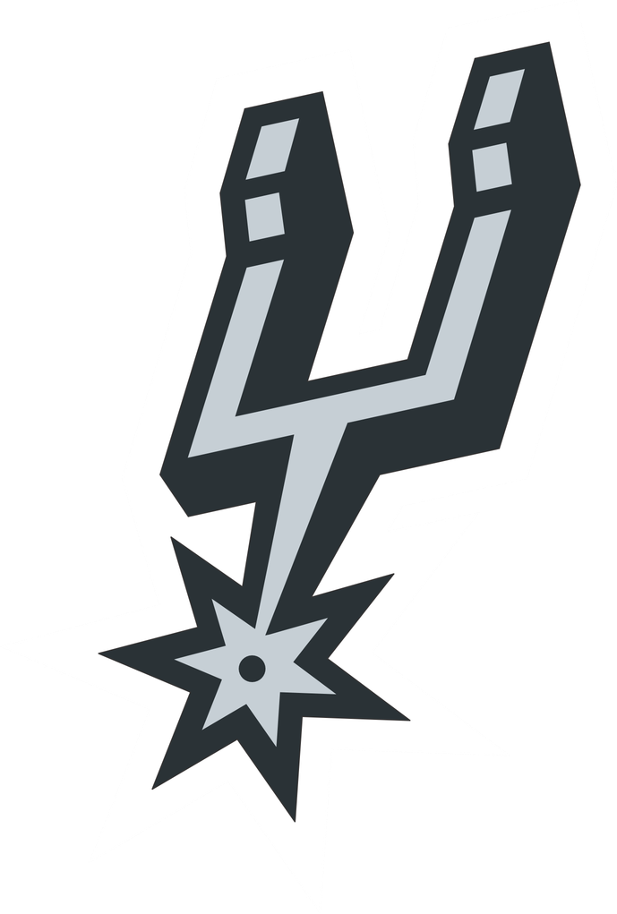
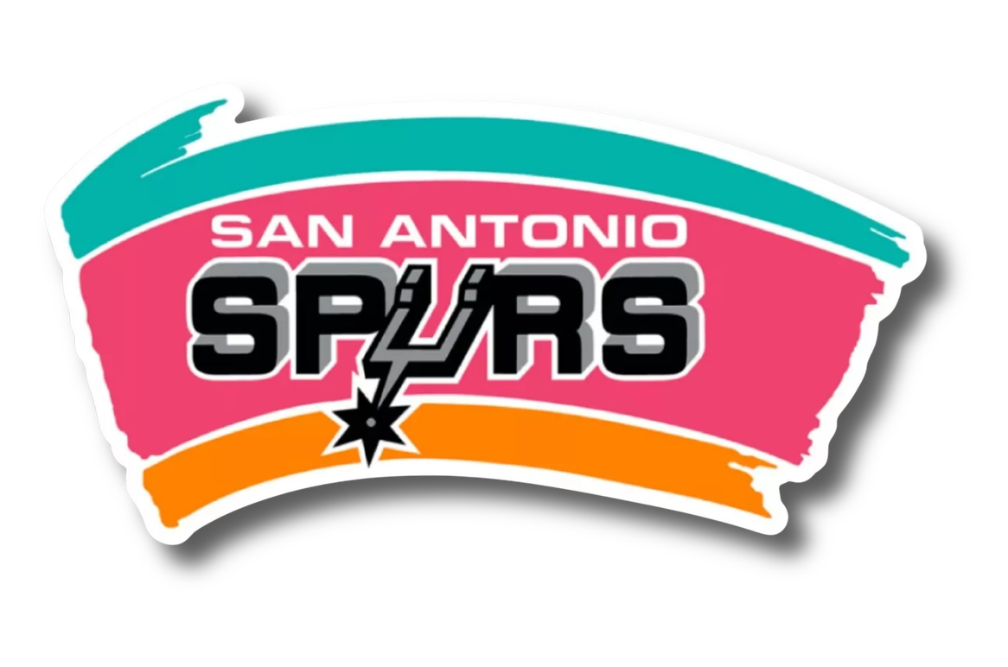
Drawing from the San Antonio logo of my childhood, I merged the iconic Spurs aesthetic with the legendary Fiesta logo to craft a truly unique colorway. My goal was to capture the high-energy, electric palette of both worlds—blending the team’s grit with the festive, 'Puro' spirit that defines our city."

Slide 4
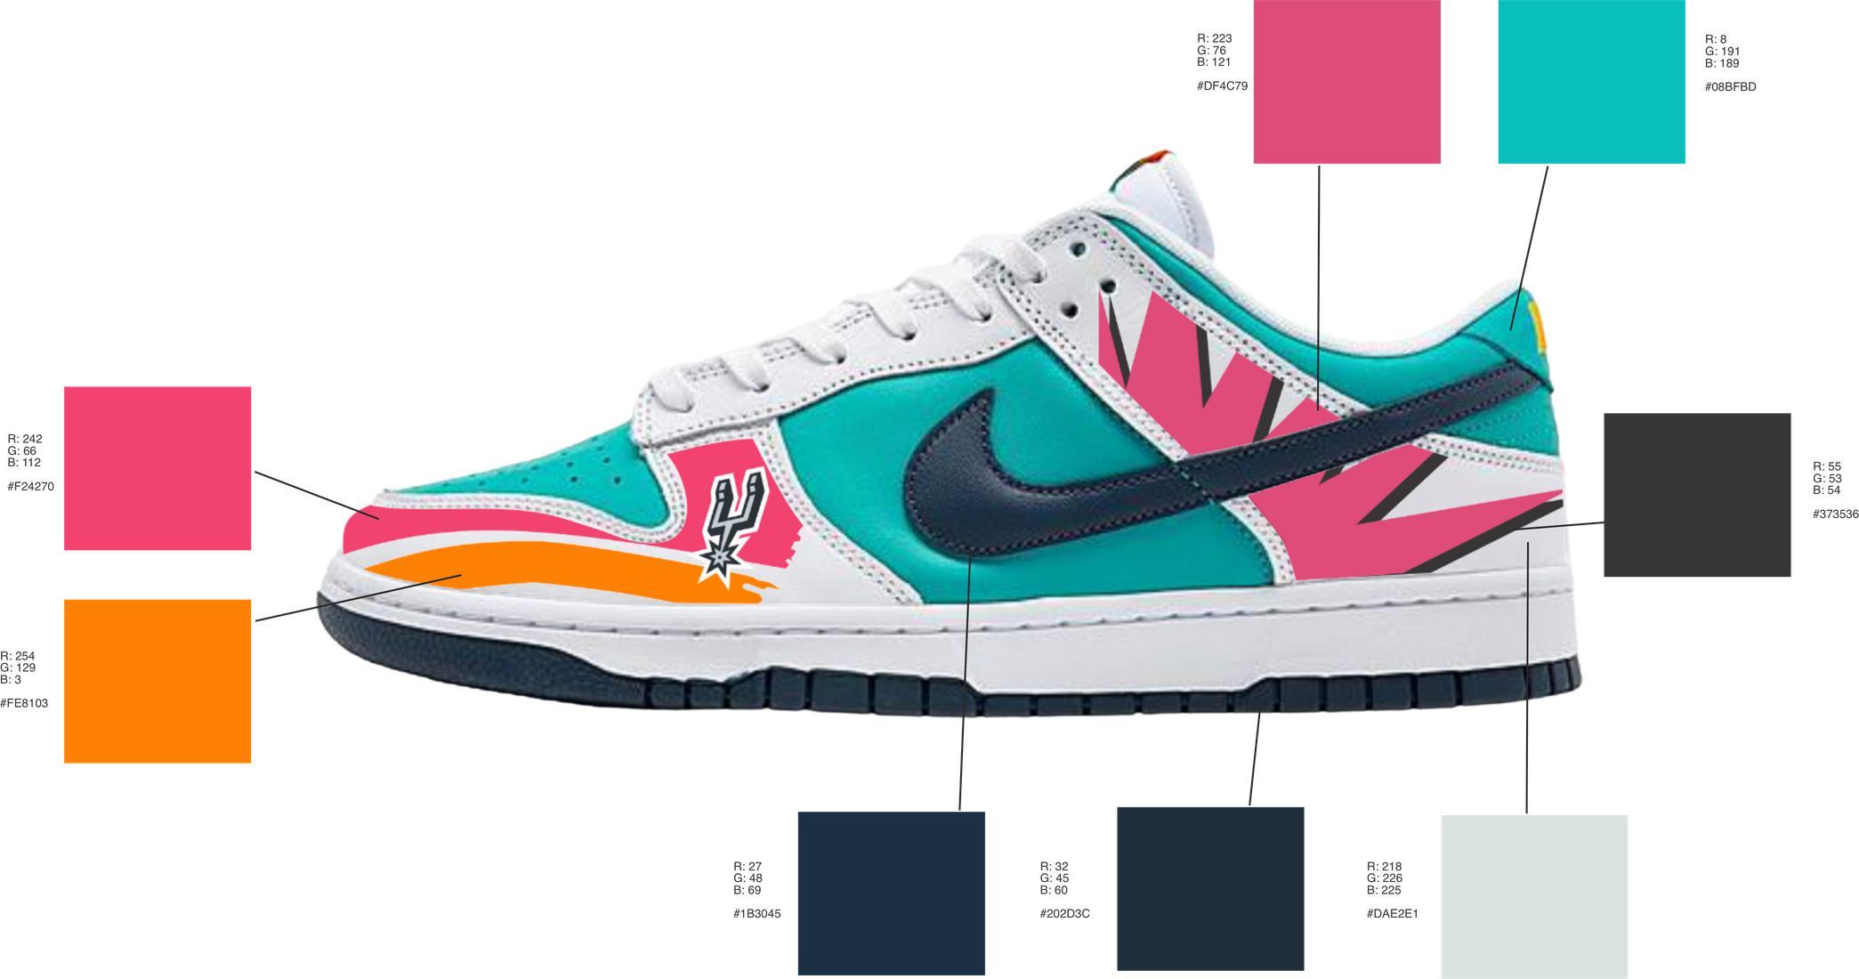
COLOR SAMPLES

Slide 5
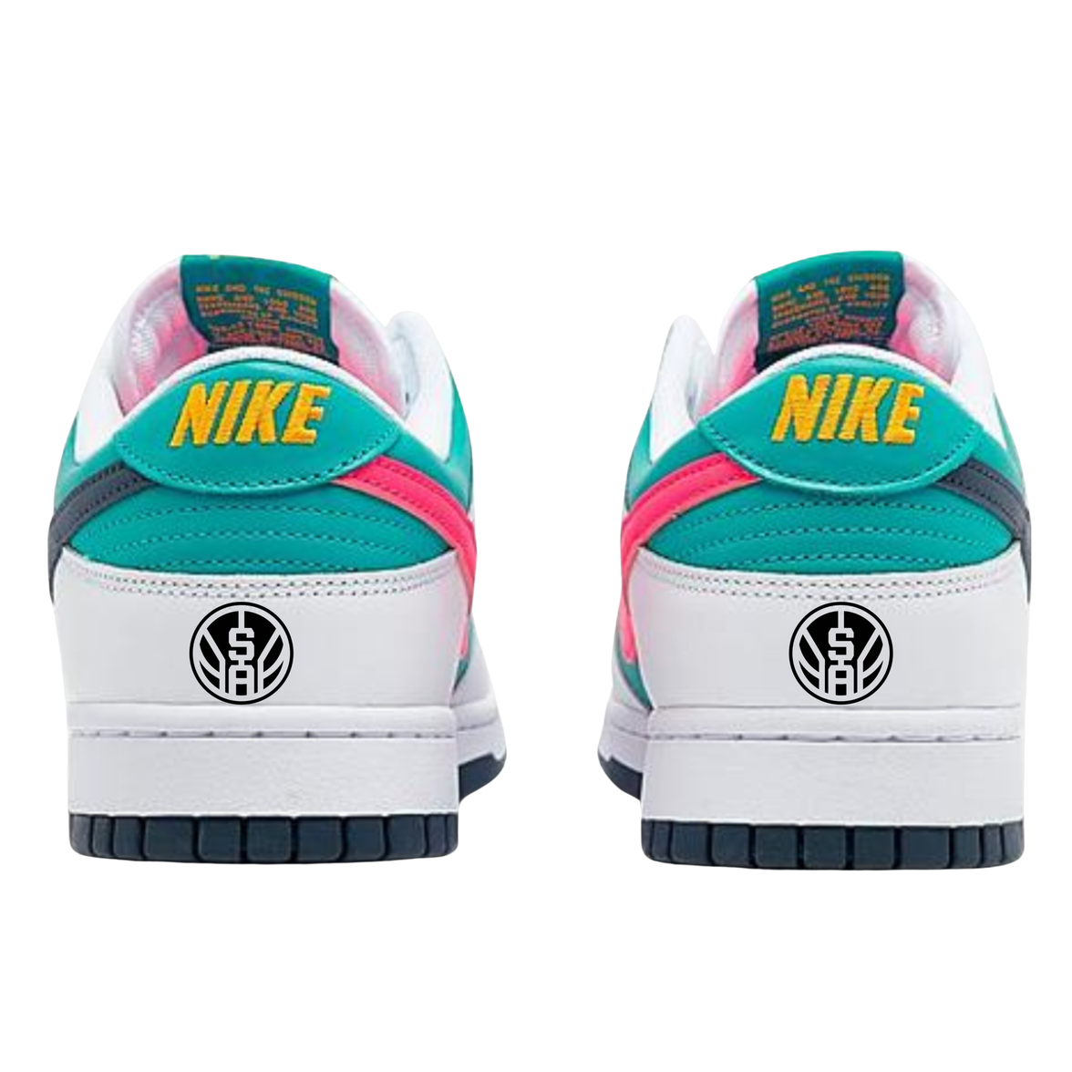
1 OF 1 CONCEPT
I wanted to create a 1-of-1 that captures the soul of San Antonio. By blending the iconic black and silver of the Spurs with the high-energy colors of Fiesta, I’ve turned an existing silhouette into a celebration of the 210. From the court to the parades, this design is built for April in the Alamo City.

Slide 6
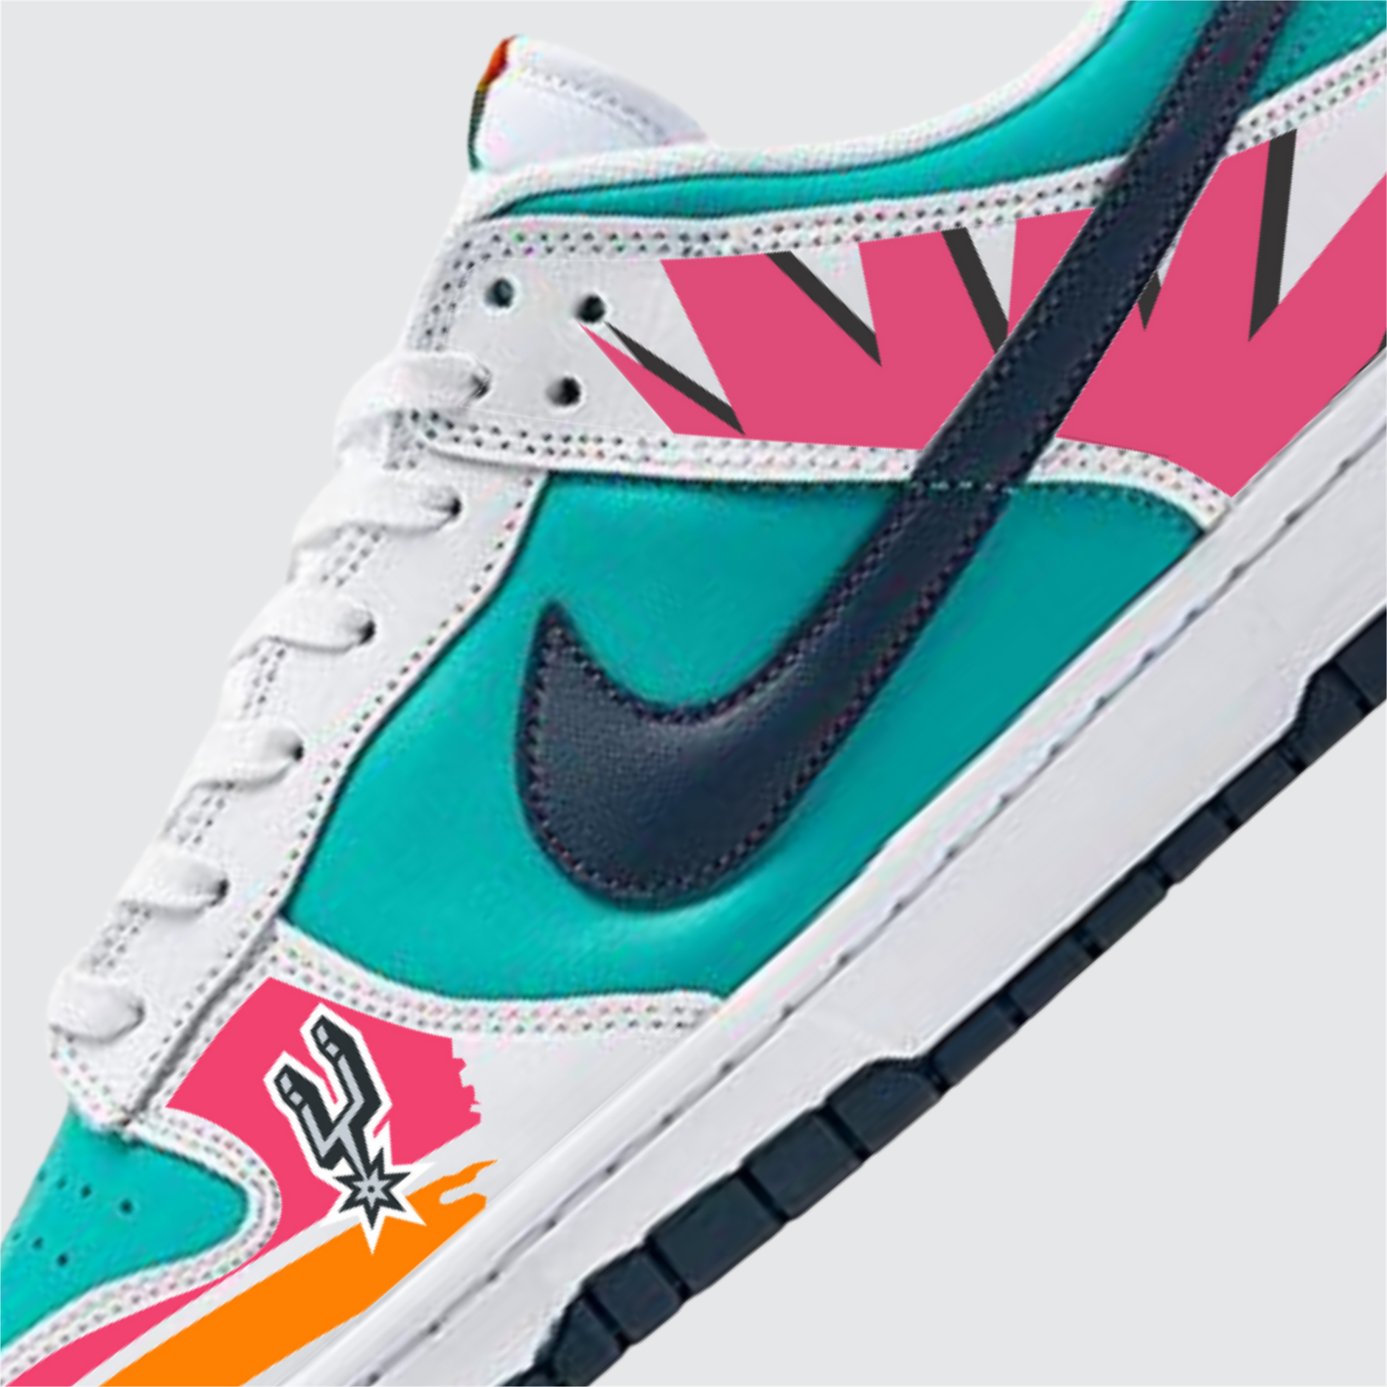
SURVEY OF PRICE
  Sample Size: 50 Participants
  Consumer Interest: 100% Affirmative (Every respondent would purchase).
  Target Price Point: $140–$150 (Identified by 40% of respondents).
Conclusion: The data reflects an enthusiastic market with a strong consensus on value, particularly within the mid-tier premium sneaker bracket.

Slide 7
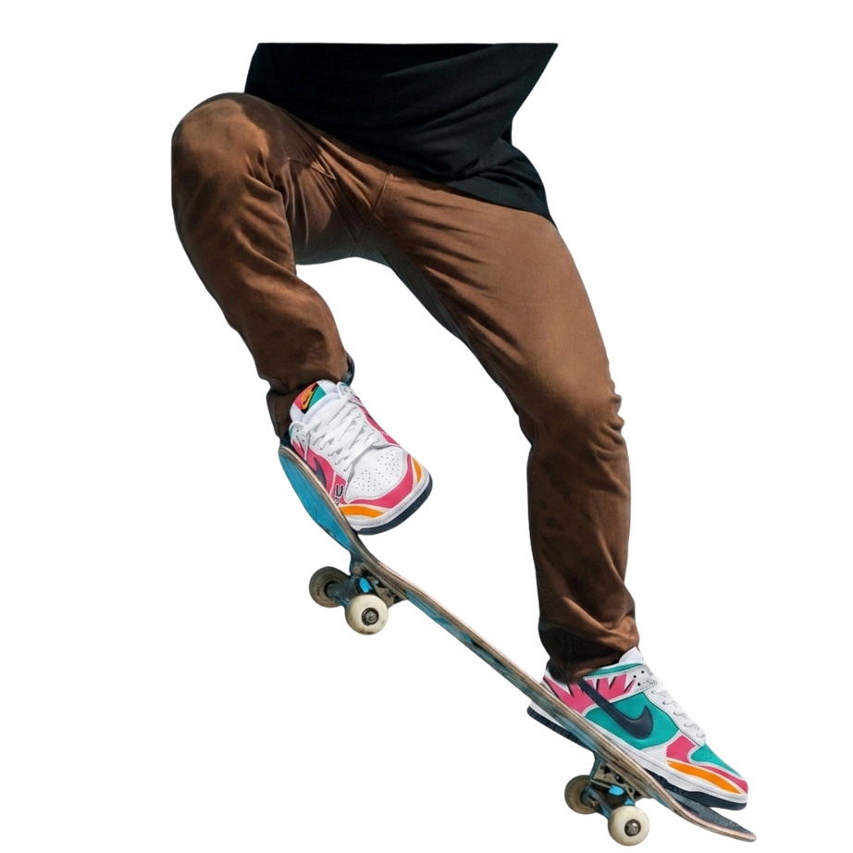
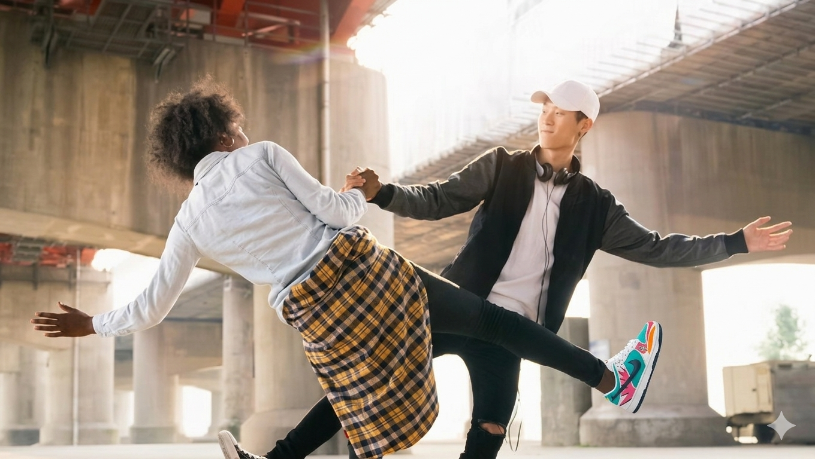
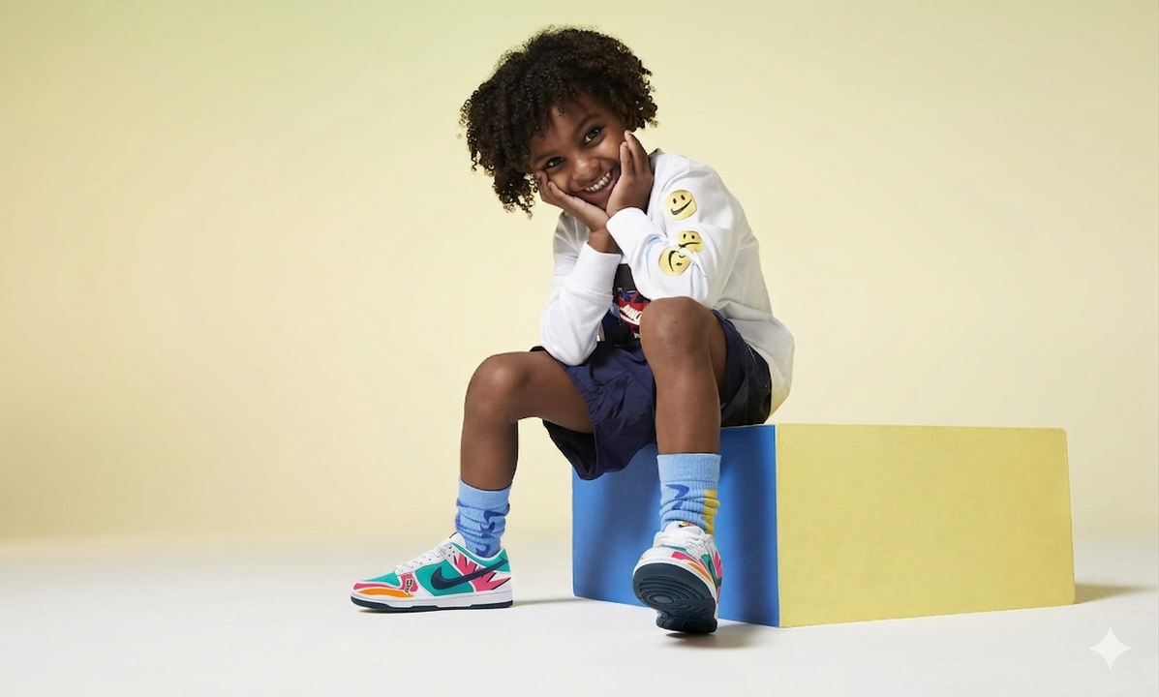
TARGET AUDIENCE
Whether you’re hitting the skate park, heading to the game, or adding to your permanent collection, this custom Dunk is for you. From the young fans to the street-style veterans and the serious collectors, I tried to bottle the energy of San Antonio into one pair of kicks..

Slide 8
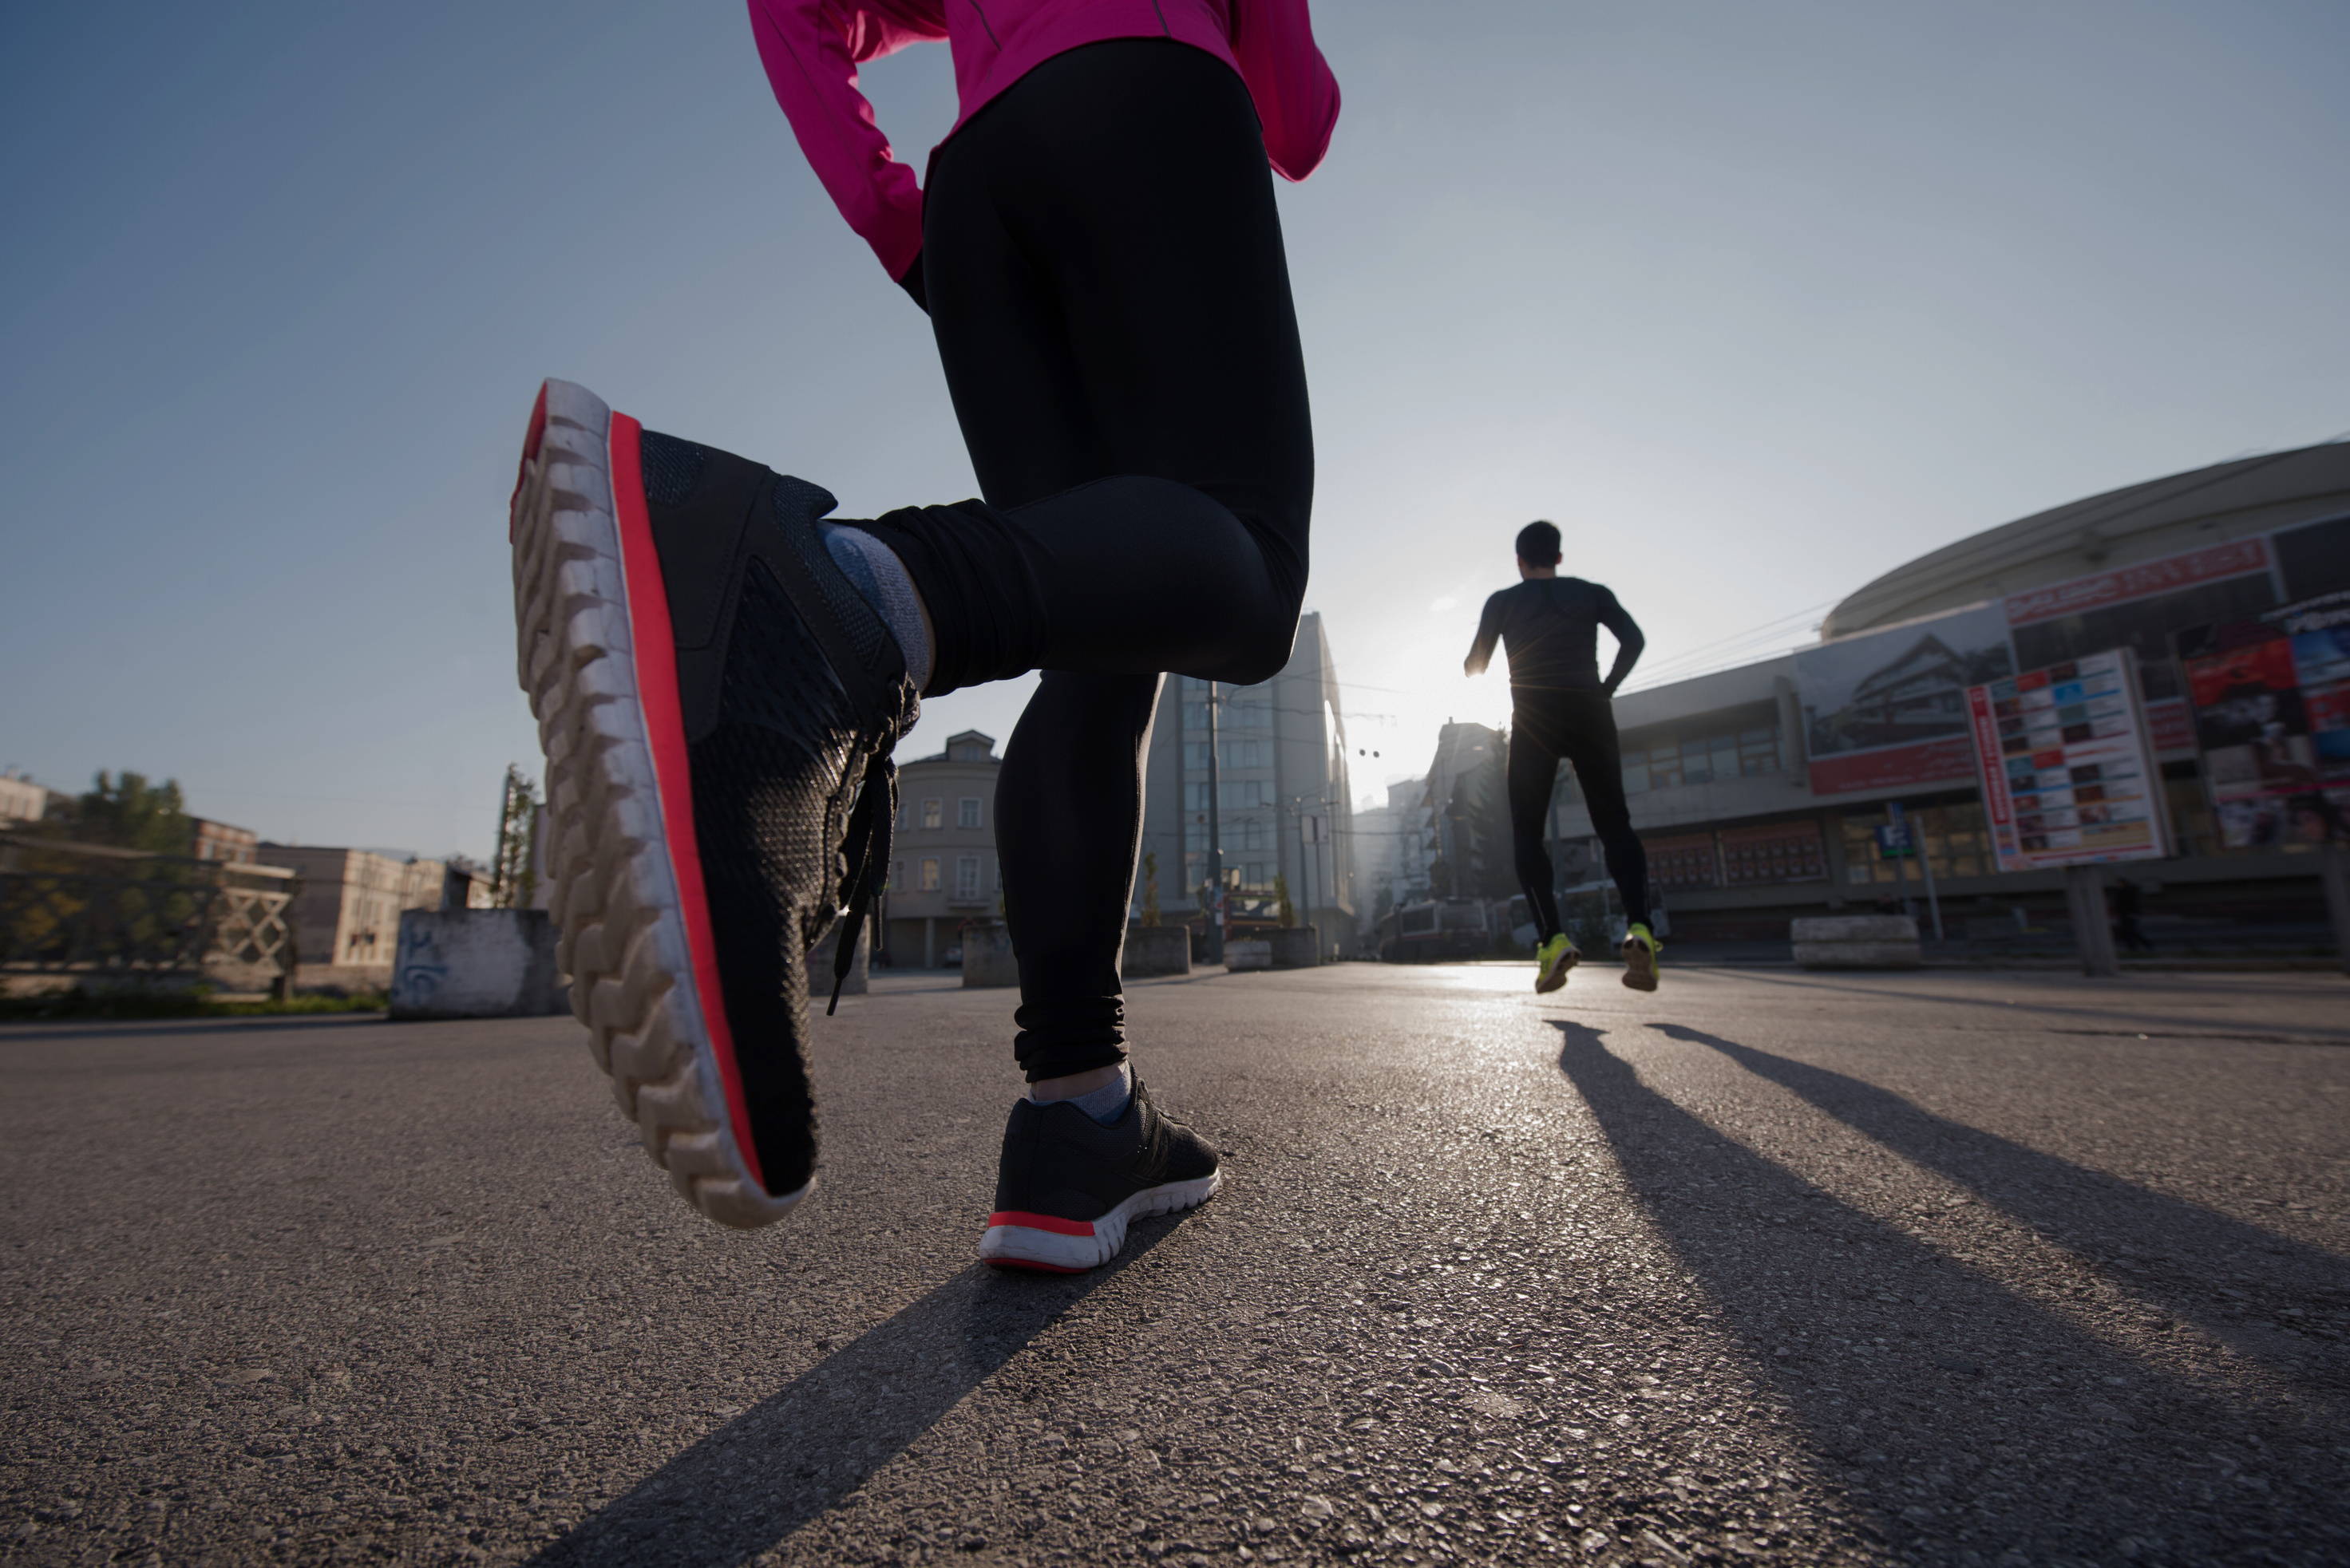
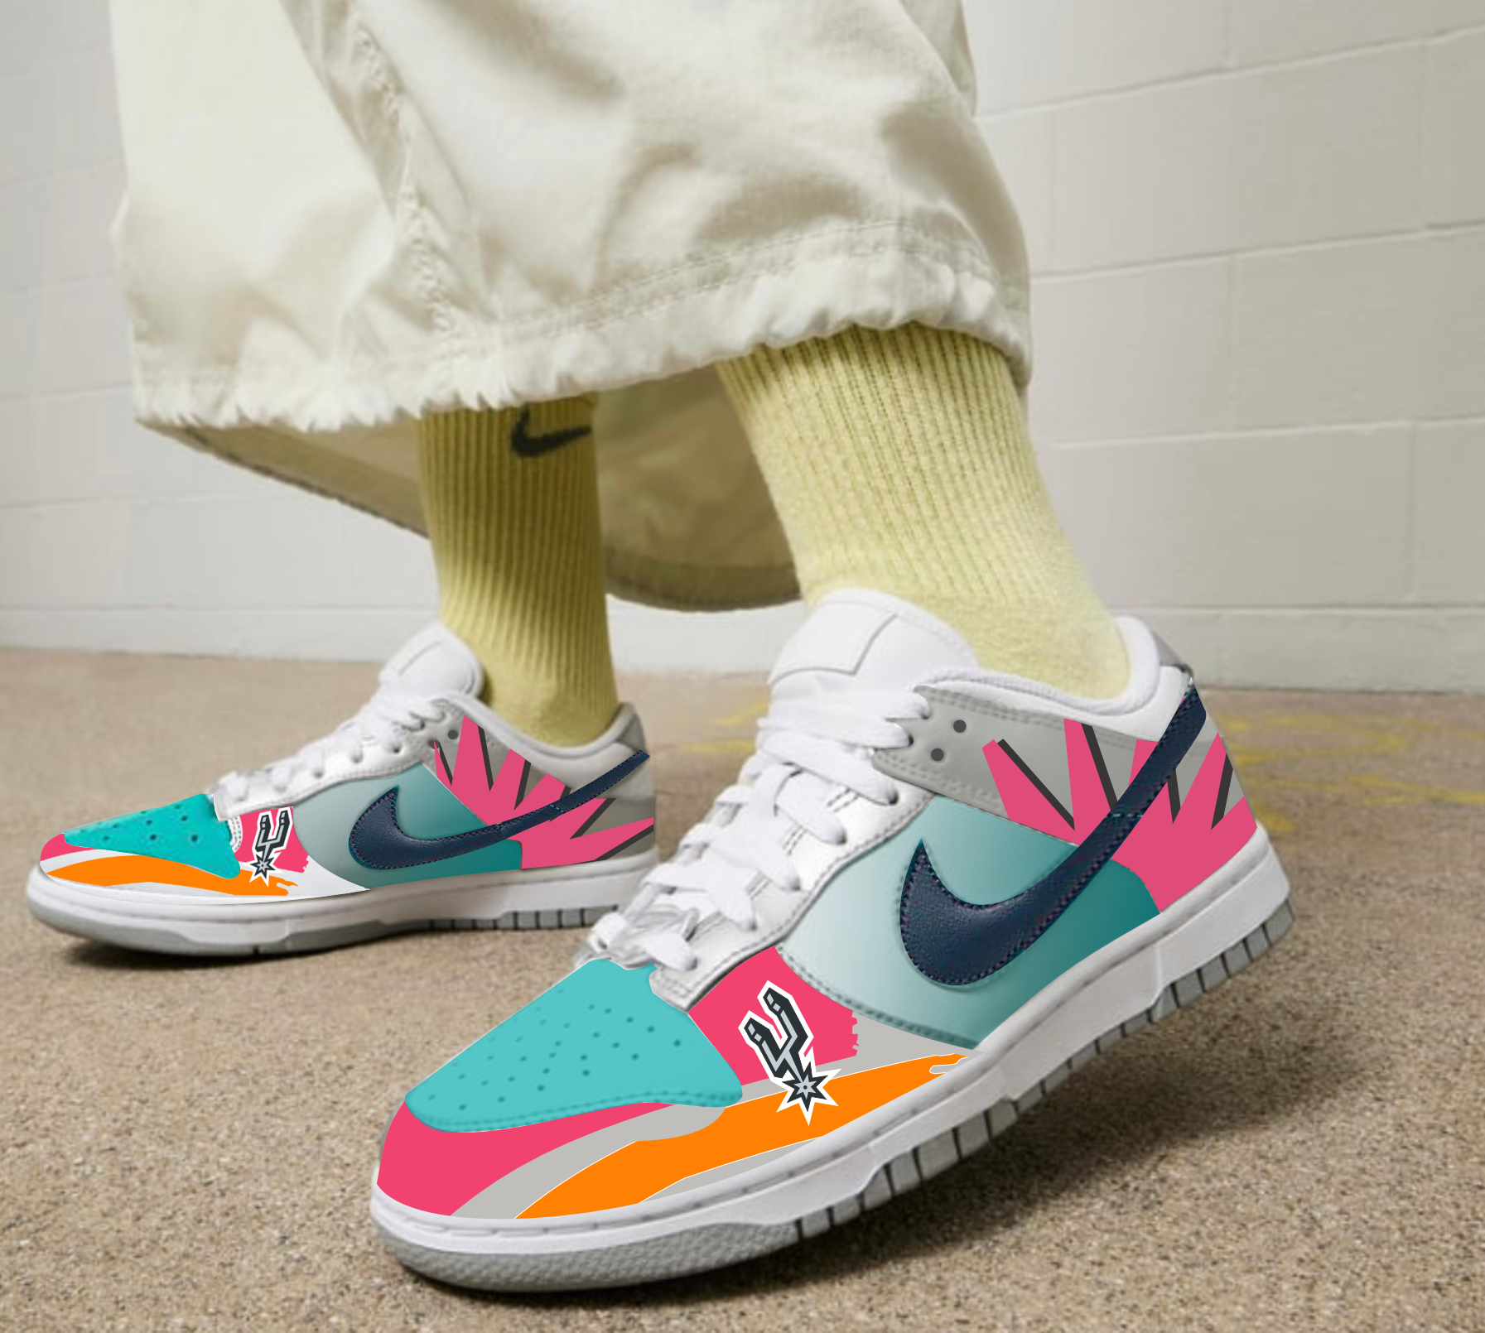
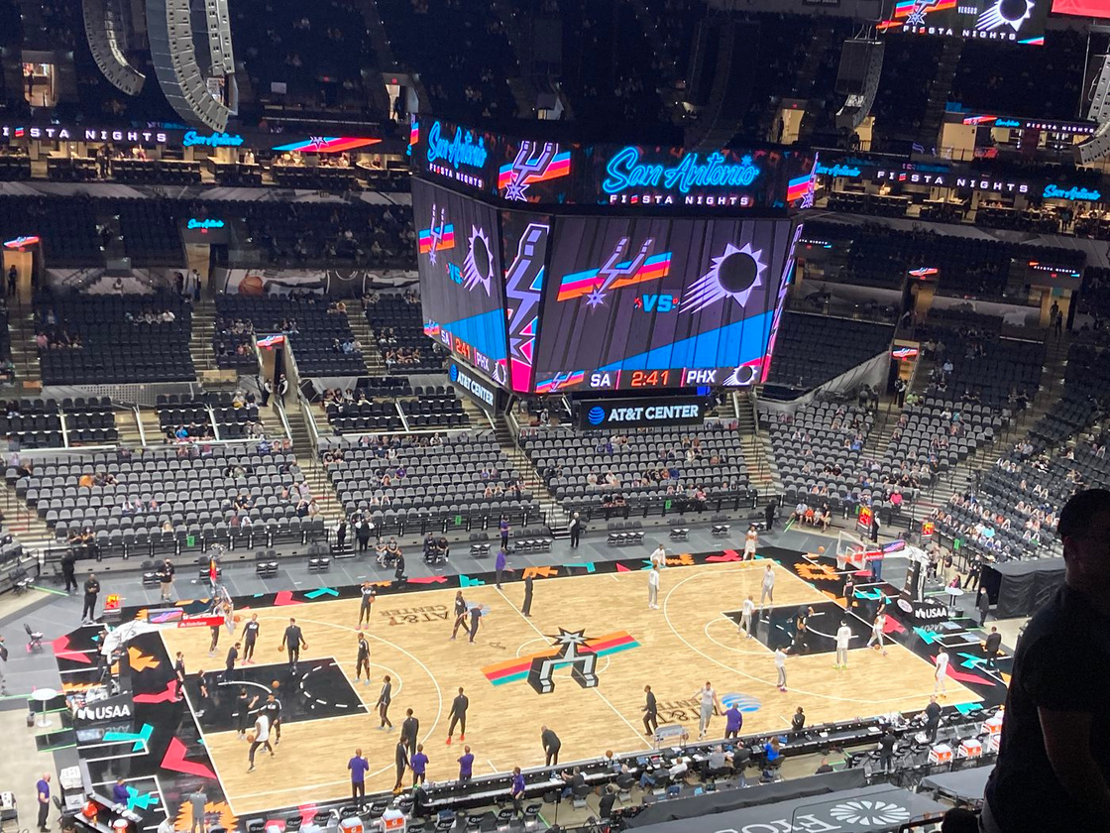
Our community spoke, and they’re ready to lace up. Whether it’s bringing the heat to a Spurs game, matching a fresh fit for a night out in San Antonio, or turning heads at the next big sneaker convention—this design is built for every occasion.
EXAMPLES OF USE

